Slide 1
Week 9 Presentation
Navigation team

Slide 2
Objectives
Generate the first user interface which primarily consists of buttons and input fields for now.
Decide on the specific elelctromechanical and steering servo actuators based on mathematical predictions done by the mechanical team.
Discuss the best alternative to replace the faulty gps sytem

Slide 3
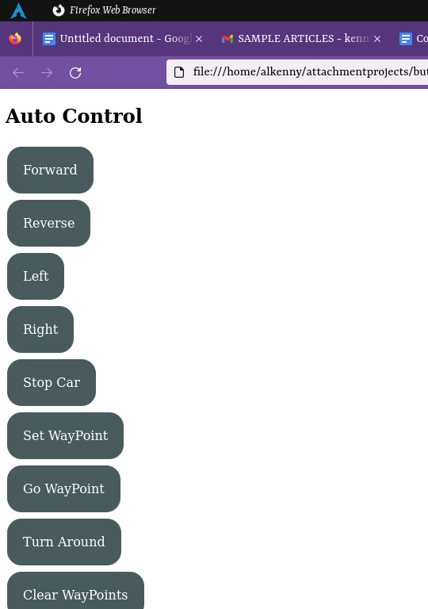
The basic interface

Slide 4
Understanding the problems
01
We were able to generate a code that was able to capture gps coordinates and give the robot waypoints to follow as paths. The backend was spitting coordinates as payloads and the espmodule was receiving them and loading them on to the arduino board.
02
The gps module was way out in terms of precision during the last test we made.. We were still working on the path correction algorithm to better the response from the robot
03
The Neo-6 GPS module eventually stopped working for some reason. But the code works.

Slide 5
Planned improvements
we are supposed to get a better gps module that has better base correction system.
Or even better, we could still resort to using the already assembled telemetry systems with high precision gps modules like cube orange from PixHawk.
The code only allows for captured waypoints to learn the path, we could implement a google map interface to easily capture the coordinates for path planning

Slide 6
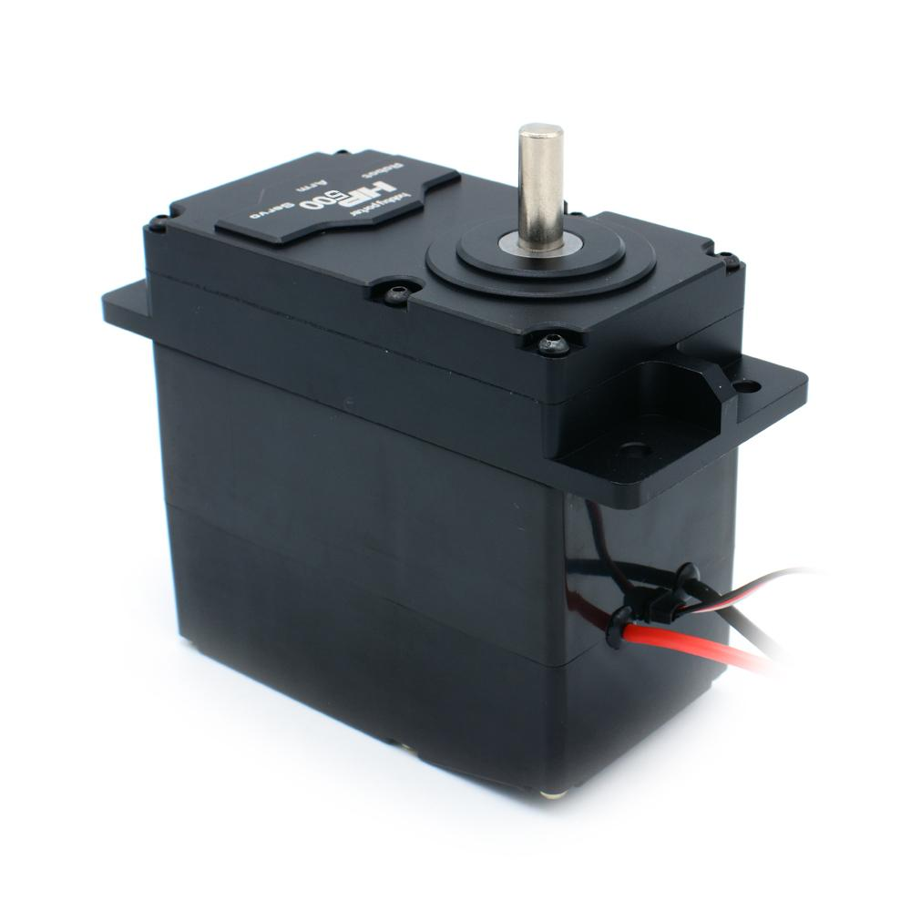

Hobby Porter Servo Motor
We decided on the Hobby Porter Servo Motor since it has the highest reliable torque. Its rated at 300KG-cm which translates to 0.3KG-m
By approximation, this translates to 30N-m which is well above the specified 17N-m from the previous meeting

Slide 7
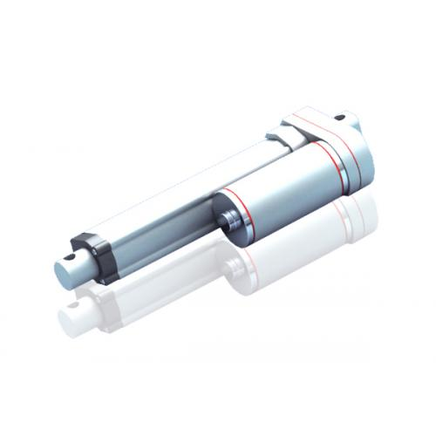
Electromechanical Actuator we chose
Operating voltage: 12VDC
Stroke Length : 200mm - which should be enough.
Static Load: 300N
Speed: 30mm/s

Slide 8
Code
The gps code for collecting waypoints from the interface is already uploaded on Github

Slide 9
Challenges
The motor shield is not sending any signals to motors at all delaying our further tests.
The GPS module is also not responding at all. We were considering finding a better module with high precision and base correction system to continue with the tests.

Slide 10
Thank you!

